Slide 1
Cellular Networks

Slide 2
Outline
Overview
Organisation
Coverage

Slide 3
Cellular Operations
Three basic devices
A mobile station
A base transceiver
A Mobile Telecommunications Switching Office (MTSO)

Slide 4
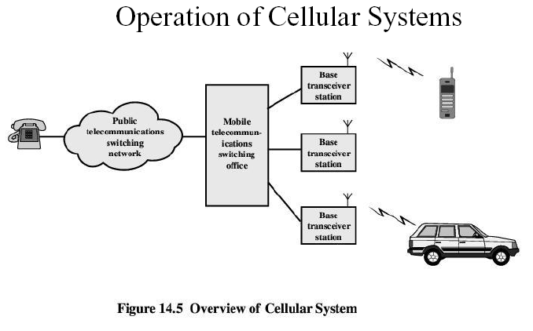

Slide 5
Cellular Network Organization
Base Station (BS)
contains an antenna, a controller, and a number of receivers
Mobile Telecommunications Switching Office (MTSO)
connects calls between mobile units
Two types of channels available between mobile unit and BS
Control channels
used to exchange information having to do with setting up and maintaining calls
Traffic channels
carry voice or data connection between users

Slide 6
Cellular Operation
Public Land Mobile Network (PLMN) refers to a cellular network that has land and radio based sections.
A public land mobile network (PLMN) (as defined in telecommunications regulation) is any wireless communications system intended for use by terrestrial subscribers in vehicles or on foot.
Such a system can stand alone, but often it is interconnected with a fixed system such as the public switched telephone network (PSTN)

Slide 7
Cellular Operation
This network consists of:
Mobile station (MS): A device used for communication over the network.
Base station transceiver (BST): A transmitter/receiver used to transmit/receive signals over the network. (Popularly known as Base Station or BS).
Mobile switching center (MSC): Sets up and maintains calls made over the network. The MSC may also be called the Mobile Telephone Switching Office (MTSO).
Base station controller (BSC): Communication between a group of BSTs and a single MSC is controlled by the BSC
Public switched telephone network (PSTN): Section of the network that is land based

Slide 8
Cellular Operation
Challenges
Irregular terrain
Base station sites are hard to find and maintain
Urban environments where there are numerous obstructions such as buildings
Many sources of radio-frequency (RF) radiation that can cause noise and interference
Security, as wireless system is inherently more susceptible to eavesdropping and unauthorized use than a wired system

Slide 9
Outgoing call from mobile station
phone number is dialed from mobile station
mobile station links to base transceiver via control channel
base station to MTSO to PSTN
MTSO routes connection back to mobile station via voice channel
mobile station shifts from control channel to voice channel

Slide 10
Incoming call to mobile station
call goes from PSTN to MTSO
MTSO searches for mobile by PAGING on control channel every active mobile
If found, MTSO rings it and establishes voice channel connection
uses transceiver with strongest signal from mobile

Slide 11
Cellular Network Organisation
Multiple low powered transmitters
100w or less
Area divided into cells
Each with own antenna
Each with own range of frequencies
Served by base station
Transmitter, receiver, control unit
Adjacent cells on different frequencies to avoid crosstalk

Slide 12
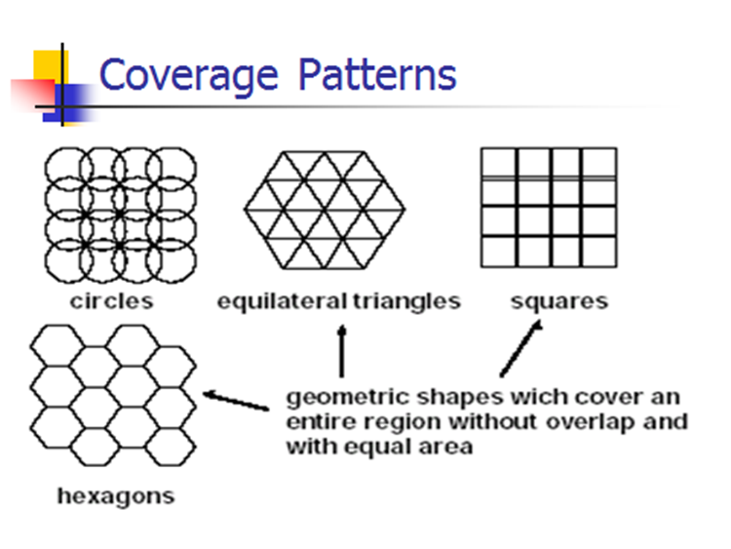
Cellular Network Organisation – possible patterns

Slide 13
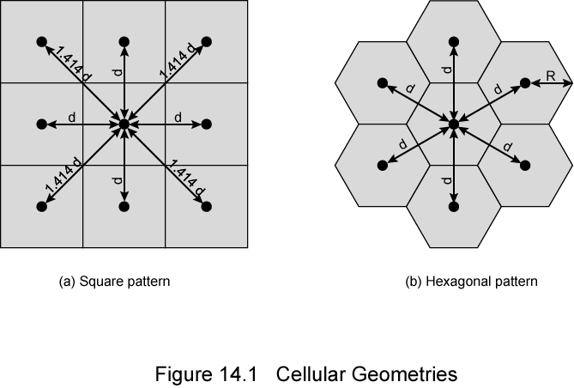
Cellular Network Organisation
Shape of Cells
Square
Width d cell has four neighbors at distance d and four at distance √2d
Better if all adjacent antennas equidistant
Simplifies choosing and switching to new antenna

Slide 14
Cellular Network Organisation
Shape of Cells
Hexagon
Provides equidistant antennas
Radius defined as radius of circumcircle
Distance from center to vertex equals length of side
Distance between centers of cells radius R is √3R

Slide 15
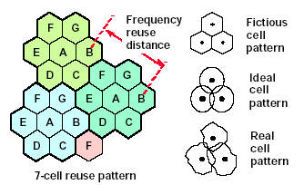
Not always precise hexagons
Topographical limitations
Local signal propagation conditions
Location of antennas
The coverage area of cells is called the footprint and is limited by a boundary so that the same group of frequencies can be used in cells that are far enough apart

Slide 16
Frequency Reuse
Power of base transceiver is controlled to avoid interference
Typically 100 w in urban area and 500 w in rural area
Allows communications within cell on given frequencies
Allows reuse of frequencies in nearby cells
Use same frequency for multiple conversations
10 – 50 frequencies per cell
Example
N cells all using same number of frequencies
K total number of frequencies used in systems
Each cell has K/N frequencies
Advanced Mobile Phone Service (AMPS) K=395, N=7 giving 57 frequencies per cell on average
AMPS is standard system for analog signal cellular telephone service in the United States and is also used in other countries

Slide 17
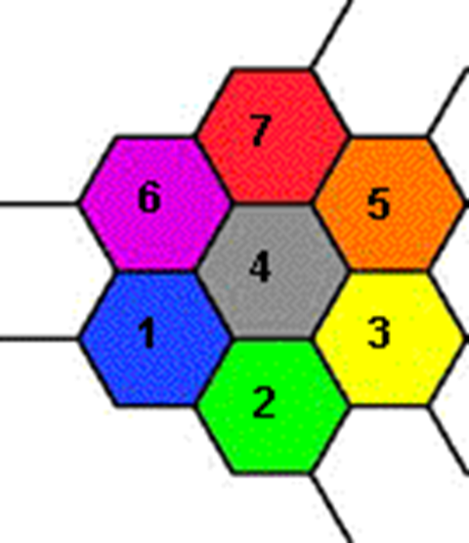
Characterizing Frequency Reuse
D = minimum distance between centers of cells that use the same band of frequencies (called cochannels)
R = radius of a cell
d = distance between centers of adjacent cells
N = number of cells in repetitious pattern
Reuse factor
Each cell in pattern uses unique band of frequencies
D/R= √ (3 x N)
D/d = √ N

Slide 18
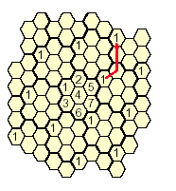
7-cell reuse pattern (i=2,j=1)

Slide 19
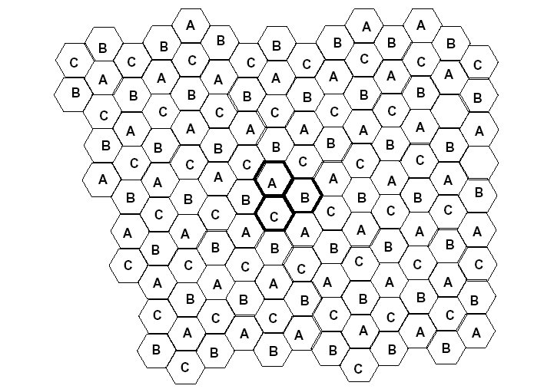
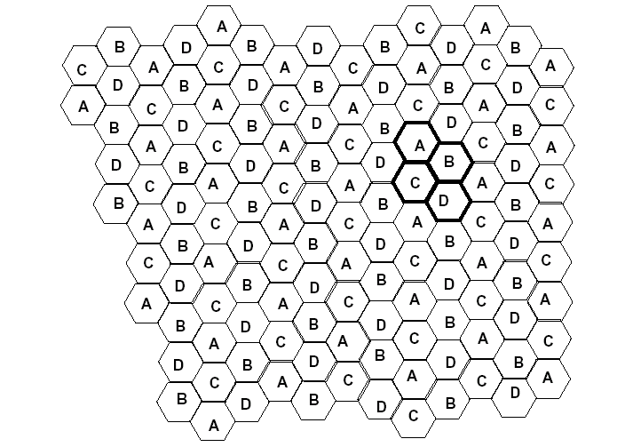
3-cell reuse pattern (i=1,j=1)
4-cell reuse pattern (i=2,j=0)

Slide 20
Reuse Pattern
Hexagonal cell pattern, following values of N possible
N = I² + J² + (I x J), I, J = 0, 1, 2, 3, …
Possible values of N are 1, 3, 4, 7, 9, 12, 13, 16, 19, 21, …

Slide 21
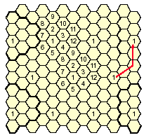
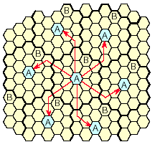
12-cell reuse pattern (i=2,j=2)
19-cell reuse pattern (i=3,j=2)

Slide 22
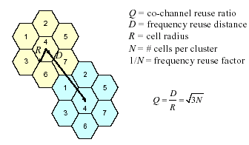
Relationship between Q and N

Slide 23
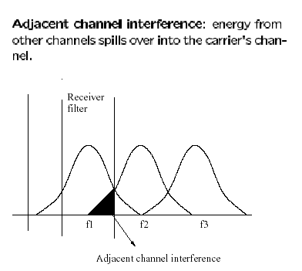
Factors limiting frequency reuse
Co-channel interference
Adjacent channel interference
can be controlled with transmit and receive filters

Slide 24
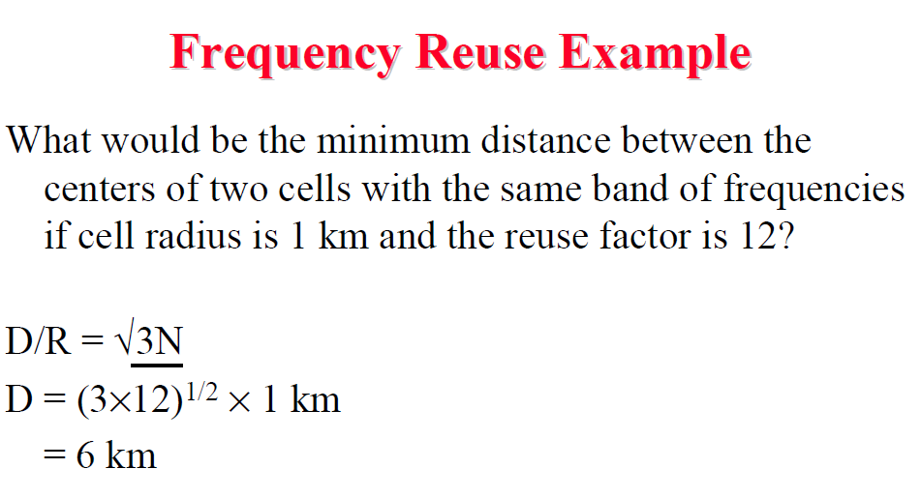

Slide 25
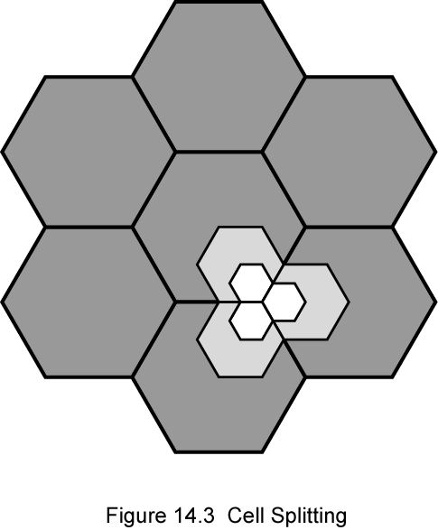
Increasing Capacity
Frequency borrowing
Frequencies are taken by congested cells from adjacent (relatively empty) cells
Or assign frequencies dynamically
Cell splitting
Non-uniform distribution of topography and traffic
Smaller cells in high use areas
cells in areas of high usage can be split into smaller cells
Original cells 6.5 – 13 km
1.5 km limit in general
Problems: (i) More frequent handoff, (ii) More base stations

Slide 26
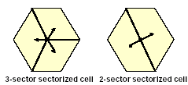
Increasing Capacity
Cell sectoring
cells are divided into a number of wedge-shaped sectors, each with their own set of channels
Subsets of cell’s channels
3 – 6 sectors per cell
Directional antennas
Microcells
antennas are moved to small buildings, lamp posts etc.
form microcells
reduced power
good for city streets, along roads and inside large buildings

Slide 27
Operation of Cellular Systems
Base station (BS) at center of each cell
Antenna, controller, transceivers
Controller handles call process
Number of mobile units may be in use at a time
BS connected to mobile telecommunications switching office (MTSO)
One MTSO serves multiple BS
MTSO to BS link by wire or wireless
MTSO:
Connects calls between mobile units and from mobile to fixed telecommunications network
Assigns voice channel
Performs handoffs
Monitors calls (billing)
Fully automated

Slide 28
How does the network know where the subscribers are?
The radio network consists of a large number of BTSs. Each of these is given an identity.
The BTSs are grouped in Location Areas which also are given an identity.
Each MSC/VLR (Mobile Services Switching Centre/Visitor Location Register) serves the BTSs in an number of Location Areas
The GSM phones report to the network (VLR) when it moves from a BTS in one Location Area to a BTS in another Location Area.
How does the network know where these subscribers are?
VLR always knows in which Location Area the GSM subscriber is located in at the moment
HLR always knows in which MSC/VLR the GSM subscriber is just now
The GSM subscriber’s telephone number tells the network to which HLR the actual GSM subscriber belongs.

Slide 29
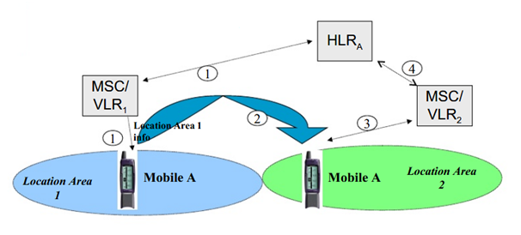
1) Mobile A is staying in Location Area 1. MSC/VLR1 has reported this to Mobile A’s HLR.
2), 3) Mobile A moves to Location Area 2, and identifies a new Location Area info (LA2). It reports its arrival to MSC/VLR 2.
4) MSC/VLR 2 informs HLRA, and receives sets of Authentication Data for Mobile A

Slide 30
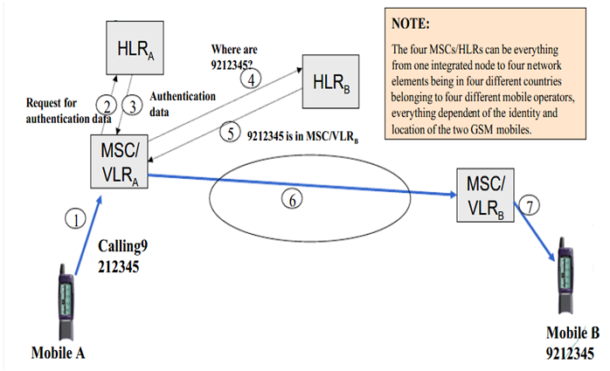

Slide 31
1) Via the radio path and the base station network a call request for GSM subscriber B 9212345 is sent from Mobile A to MSC/VLR A.
2-3) MSC/VLR A collects authentication data from HLR A (if such data has not been collected earlier). Normally a bulk of such data is transferred, thus avoiding repeating authentication requests to HLR A.
4) MSC/VLR A requests HLR B of the actual location of GSM subscriber B.
5) Gateway MSC checks with HLR B “Where is the GSM subscriber?”
6) The call is established to the actual MSC/VLR (Visiting MSC) either directly or through the fixed or international telephone network
7) The request for mobile 9212345 is transmitted over all BTSs in the actual Location Area of the called GSM subscriber. Mobile B recognises its own identity, and ringing is generated.

Slide 32
Typical Call in a single MTSO area
Mobile unit initialization
Scan and select strongest set up control channel
Automatically select BS antenna of cell
Usually the nearest, but not always
Handshake to identify user and register location
Scan repeated to allow for movement
Change of cell
Mobile unit monitors for pages (see below)
Mobile originated call
Check set up channel is free
Monitor forward channel (from BS) and wait for idle
Send number on pre-selected channel
Paging
MTSO attempts to connect to mobile unit
Paging message sent to BSs depending on called mobile number
Paging signal transmitted on set up channel

Slide 33
Typical Call in a single MTSO area
Call accepted
Mobile unit recognizes number on set up channel
Responds to BS which sends response to MTSO
MTSO sets up circuit between calling and called BSs
MTSO selects available traffic channel within cells and notifies BSs
BSs notify mobile unit of channel
Ongoing call
Voice/data exchanged through respective BSs and MTSO
Handoff
Mobile unit moves out of range of cell into range of another cell
Traffic channel changes to one assigned to new BS
Without interruption of service to user

Slide 34
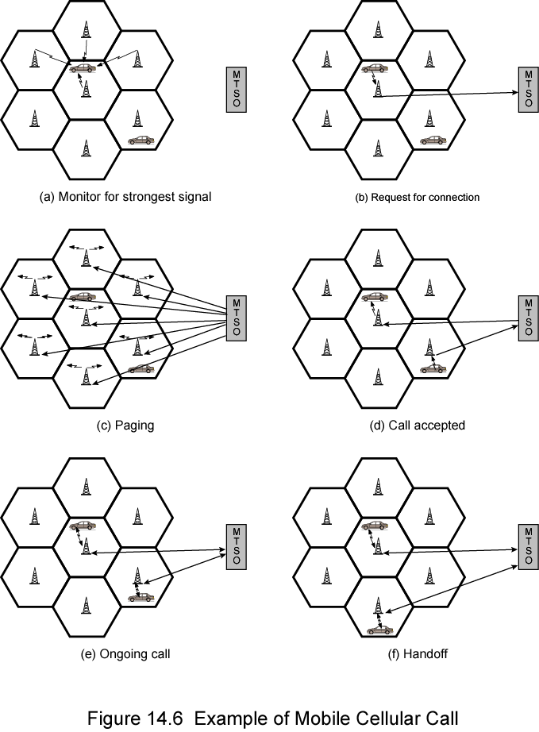
Call stages

Slide 35
Handoffs
Network protocols must refresh and renew paths as a mobile station moves between cells.
End-to-end connectivity should be preserved in a dynamically reconfigured network topology.
Handoffs (typically 30 mseconds):
At any time, mobile station (MS) is in one cell and under the control of a BS
When a MS leaves a cell, BS notices weak signal
BS asks surrounding BSs if they are getting a stronger signal
BS transfers ownership to one with strongest signal
MTSO assigns new channel to the MS and notifies MS of new BS

Slide 36
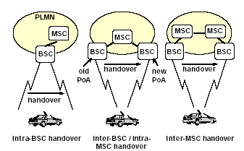
Handoffs

Slide 37
Other operations
Call blocking
During mobile-initiated call stage, if all traffic channels busy, mobile tries again
After number of fails, busy tone returned
Call termination
User hangs up
MTSO informed
Traffic channels at two BSs released
Call drop
BS cannot maintain required signal strength
Traffic channel dropped and MTSO informed
Calls to/from fixed and remote mobile subscriber
MTSO connects to PSTN
MTSO can connect mobile user and fixed subscriber via PSTN
MTSO can connect to remote MTSO via PSTN or via dedicated lines
Can connect mobile user in its area and remote mobile user

Slide 38
Location Services
Cell-id based location.
assigned an id of the cell that you are in.
cell-id is stored in a database.
As the user moves from one cell to another, s/he is assigned a different cell-id and the location database is updated.
most commonly used location databases in cellular networks are HLR, VLR
Neighborhood polling: Connected mobile units only move to adjacent cells
Angle of arrival (AOA). the angle at which radio waves from your device "attack" an antenna is used to calculate the location of the device.
Time taken. In this case, the time taken between the device and the antenna is used to calculate the location of the device.
Network assisted Global Positioning System (GPS). a GPS chip is installed inside a phone and thus the location of the user is tracked.

Slide 39
Location Services
Some concepts
A location area is a set of base stations that are grouped together.
Mobile station performs location updating when it moves to a new location area or a different PLMN.
The location updating message is sent to the new VLR. The new VLR informs the HLR. When the mobile station is authorized by the new VLS, HLR cancels its registration with the old VLR.
Mobiles are responsible for detecting location area code.
A location updating is also done periodically. If a mobile station does not update its location information after a time period, it is deregistered.
When a mobile station is paged for a call and it does not reply, a “mobile not reachable” flag (MNRF) is set in both VLR and its HLR. The flag is cleared only when the mobile does its next periodic update.

Slide 40
Cell 1
Mobile
Telephone
Switching
Center
(MTSC)
Public
Switched
Telephone
Network
(PSTN)
Cell 2
HLR
VLR
Mobile User
Base Transceiver Station (BTS)
Cordless connection
HLR = Home Location Register
VLR = Visitor Location Register
Wired connection

Slide 41
Location Services
Home location register (HLR) database – stores information about each subscriber that belongs to the covering area of a MSC.
It stores the current location of these subscribers and the services to which they have access.
The location of the subscriber corresponds to the SS7 address of the Visitor Location Register (VLR) associated to the terminal.
Visitor location register (VLR) database – maintains information about subscribers currently physically in the region.
When a subscriber enters the covering area of a new MSC, the VLR associated to this MSC will request information about the new subscriber to its corresponding HLR.
The VLR will then have enough information to assure the subscribed services without needing to confirm with the HLR each time a communication is established.

Slide 42
GSM Location Services
6
2
9
BTS
Terminating
MSC
Gateway
MTSC
10
Public
Switched
Telephone
Network
(PSTN)
1
10
10
9
10
7
8
5
3
4
VLR
HLR
10
5
1. Call made to mobile unit (cellular phone)
2. Telephone network recognizes number
and gives to gateway MSC
3. MSC can’t route further, interrogates
user’s HLR
4. Interrogates VLR currently serving user
(roaming number request)
5. Routing number returned to HLR and
then to gateway MSC
6. Call routed to terminating MSC
7. MSC asks VLR to correlate call to the subscriber
8. VLR complies
9. Mobile unit is paged
10. Mobile unit responds, MSCs convey
information back to telephone

Slide 43
Paging
Paging is one-to-one communication between the mobile and the base station.
Paging is performed to find a subscriber’s location before a call establishment.
Paging is used to alert a mobile station about an incoming call.
Paging is based on the location information of the mobile station provided during the last update.

Slide 44
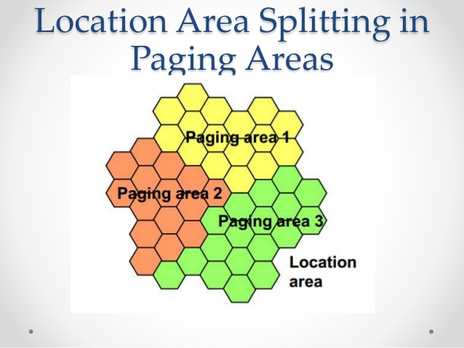

Slide 45
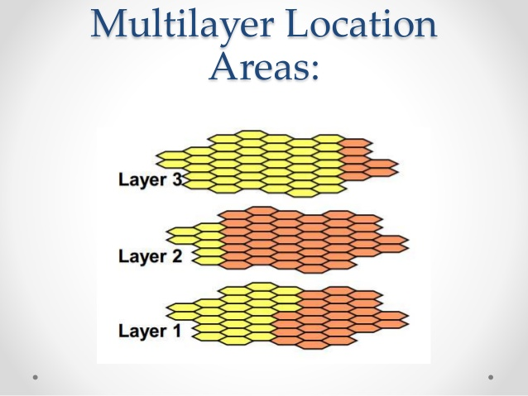

Slide 46
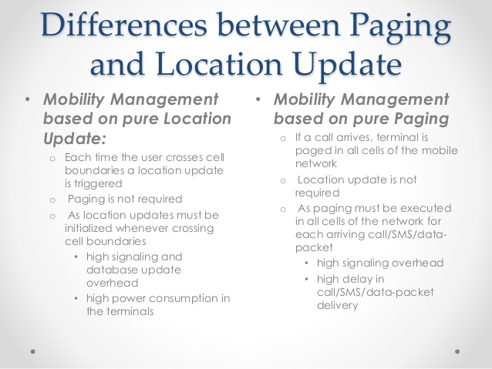

Slide 47
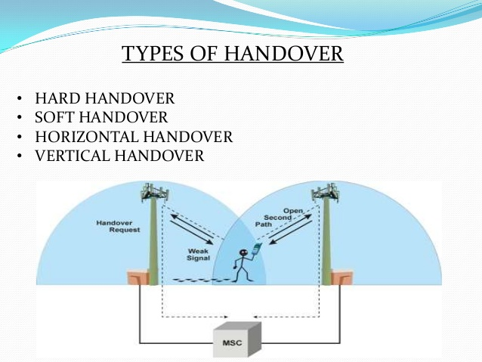
Types of handoff
Hard handoff
Soft handoff
Horizontal handoff
Vertical handoff

Slide 48
Hard handoff
“Break before make”
Primarily used in FDMA and TDMA (e.g. GSM).
Old connection is discontinued before connecting to the new base station.
Relatively cheaper and easier to implement.
Phone’s hardware does not need to be capable of receiving two or more channels in parallel.

Slide 49
Soft Handoff
“Make before break”
Used in UMTS to improve signal quality.
Uplink and downlink may be combined for better signal.
Better connection reliability.
Seamless handoff
The call is first connected to a new base station and then disconnected with the previous base station.
The call will be established only when a reliable connection to the new base station is obtained. Thus the MS is linked to two BSs for a brief interval of time.

Slide 50
Soft Handoff
Offers reliable continuity in network connection and less chances of termination of a call.
Commonly used in CDMA systems that enable the overlapping of the coverage zones, so that every mobile station is always within an effective range of at least one base station.
Technical implementation is more expensive and complex.
Used in sensitive communication services.

Slide 51
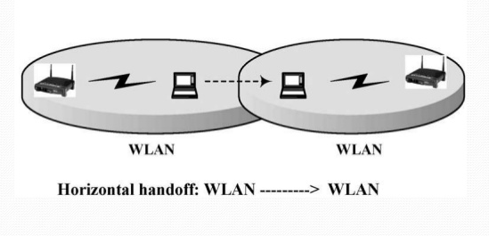
Horizontal Handoff
When mobile station changes its point of connection within the same type of network.
E.g. from a cell in GSM network to another cell in GSM network.
E.g. from one access point to another in a WiFi
Reasons –
Worse signal quality or loss of signal
Traffic load balancing
Cost

Slide 52
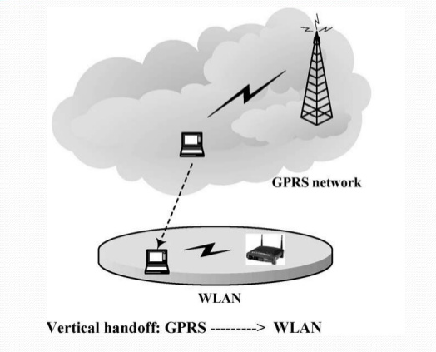
Vertical Handoff
Refers to a network node changing the type of connectivity it uses to access a supporting infrastructure.
Can use different access technologies
Can use multiple network interfaces
Can use multiple IP addresses
Can use multiple QoS parameters
Can use multiple network connection
(multihoming)

Slide 53
Handoff failures
Frequencies cannot be reused in adjacent cells.
Thus, if all channels in a cell are in use, and a mobile station moves into it with a live call, no new frequency can be assigned to it and the call is terminated.

